Slide 1








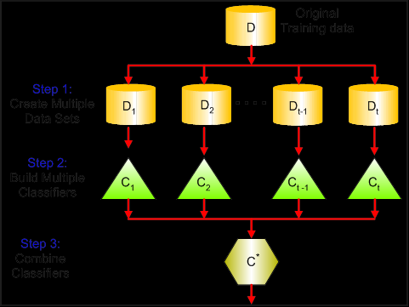

Data Service Intern, Copart Inc.
Divya Jayaprakash
M.S. Information Technology and Management
About The Company
Project: Vehicle Valuation Service
Tools and Methods
Copart, Inc. is an online vehicle auctioning business, headquartered in Dallas, Texas. www.copart.com
The company holds contracts with many insurance companies and sells the salvaged cars owned by them through online auctions
Copart has also recently ventured into a project called “Drive” to sell second-hand non-salvaged cars
It sells the high configuration sports cars through its project called “Crashed Toys”
Hence, Copart is well-established as the ultimate destination for used car purchase and sale across USA, Canada and U.K.
Project was named the PROQUOTE 4.1.5
Gradient Boosting is an ensemble of many classifiers. Prediction is made based on the vote by all the classifiers
Developed 4 sophisticated random forest models to predict the auctioned car price for USA, UK, Canada and Ireland
Periodically utilized the latest 9-month sales data of 500000+ records to update the models every month
Performed bagging and boosting of the model to decrease the misclassification rate by 41%
Integrated the R based model with restful webservice for the clients to view the latest car price each day
The product was rolled out across Great Britain, Ireland and Brazil
All the insurance company clients of Copart were happy and this enabled us to win their confidence in the business and have an edge over the competitors
Bagging and Boosting Model Diagram: D-Data , C-Classifier
Technologies: R programming, Drools, Spring, REST
Tools: JIRA, R-Studio, IntelliJ, DBeaver, Spinnaker,
Jenkins, ADP, PostMan, Kie-Session
Methods: Agile Methodology, Gradient Boosting Data-modelling, Web Service
Delivered Results
Automation of data models for sale predictions
Web-service for client view; based on the predicted price , the client decides whether to sell the car through Copart or not
Database designed in MariaDB to store and process the 9-month sales data
Responsibilities
Technical Roles
To create random forest data models for sales prediction
To integrate the R-models with Spring application
To develop currency conversion module
To develop a java application for the client webservice
To create proof of concept and to configure content-management service
Managerial Responsibilities
To conduct scrum meeting documents
To split the tasks among the team members
To manage product release activities
To coordinate between the development and the QA teams
To create and manage task tickets on the JIRA tool
Conclusion
In this fall internship, I learnt how to create a complete machine learning pipeline. I learnt that data analytics stands as an important edge for various predictions in the business flow. Marketing is solely based on historic data. I also understood that IT and project management are integral part of a business, specially in multinational operations.
Contact
Name: | Divya Jayaprakash
Major: | M.S. Information Technology and Management
Email: | dxj160830@utdallas.edu
Cell Phone: | 469-996-7764

